Slide 1
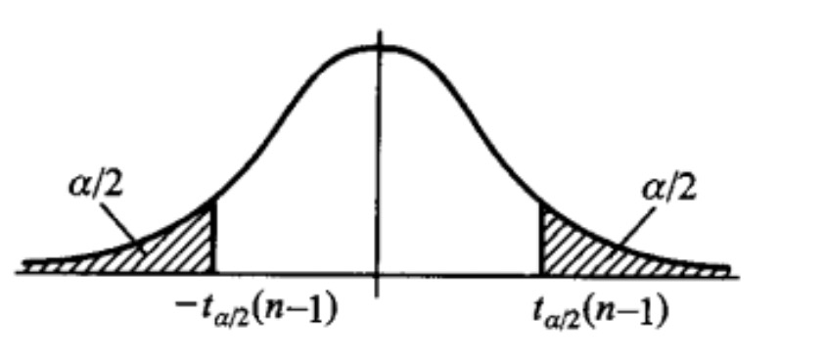
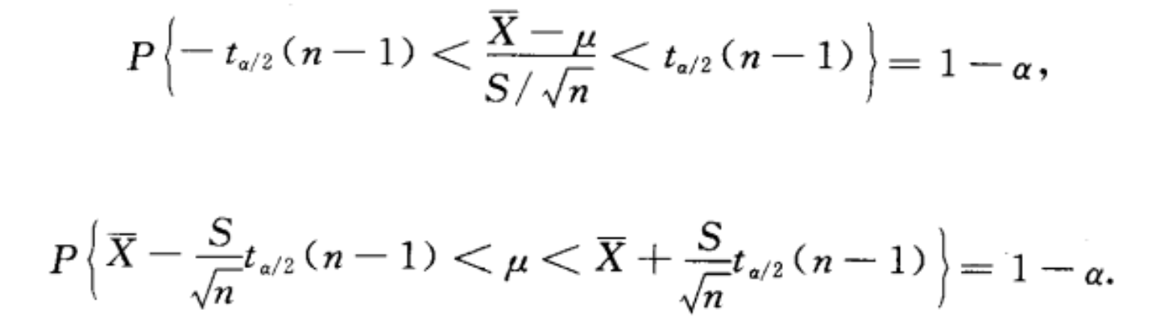

Slide 2
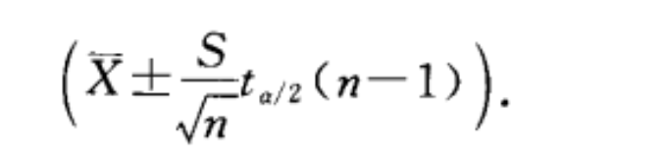
We don’t know the sd, so we estimate it.
confidence interval is
1-alpha=0.98 => alpha = 0.02 => alpha/2 = 0.01
u = 500
n-1 = 9

Slide 3
The engineer always sets a level of confidence of 98% for these tests. Find a rejection region for the test at this level. Is the value of the test statistic inside or outside the rejection region? What is your conclusion?

Slide 4
Problem7
We can find that p value is smaller.
The larger the sample size, the narrower the calculated confidence interval and the higher the precision, and the smaller the p-value will be.
Because the larger the sample size, the smaller the sampling error, when the sample size is as much as the overall (equivalent to the census), there is no sampling error, the more narrow the calculated confidence interval into only one value.

